Slide 1
Array & String in JavaScript
Exploring Array Methods, String Functions, and Looping

Slide 2


Array Functions (Push, Pop, Shift, Unshift, Splice)
Introduction to Arrays
Definition: An array is a collection of elements, each identified by an index.
Syntax :
Example :

Slide 3

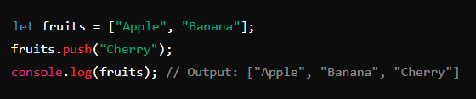
Array Method: Push
Purpose: Adds one or more elements to the end of an array.
Syntax :
Example :

Slide 4

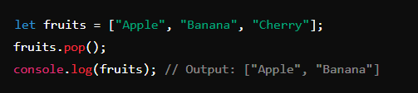
Array Method: Pop
Purpose: Removes the last element from an array.
Syntax :
Example :

Slide 5

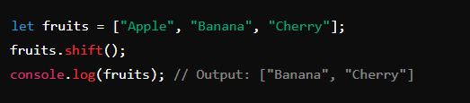
Array Method: Shift
Purpose: Removes the first element from an array.
Syntax :
Example :

Slide 6

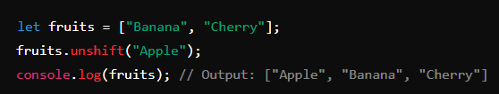
Array Method: Unshift
Purpose: Adds one or more elements to the beginning of an array.
Syntax :
Example :

Slide 7
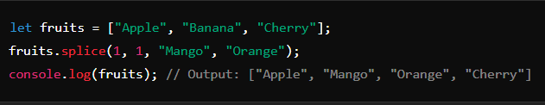
Array Method: Splice
Purpose: Adds/Removes elements from an array at a specific index.
Syntax :
Example :

Slide 8

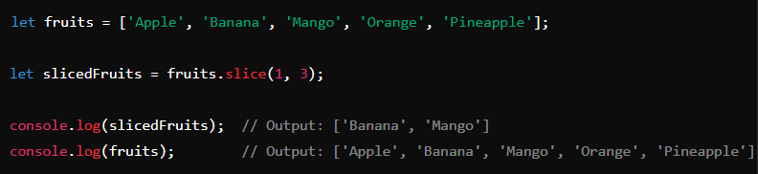
Array Method: Slice
Purpose : The slice() method in JavaScript is used to extract a section of an array or string and return it as a new array or string without modifying the original array or string.
Syntax :
Example :

Slide 9


Introduction to Strings
Definition: A string is a sequence of characters.
Syntax :
Example :

Slide 10
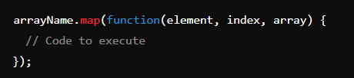
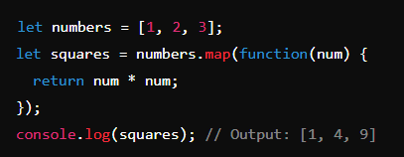
Array Method: map
Purpose: Creates a new array with the results of calling a provided function on every element in the array.
Syntax :
Example :

Slide 11
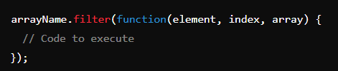
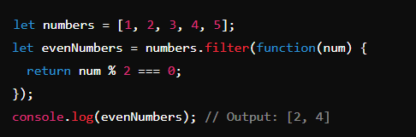
Array Method: filter
Purpose: Creates a new array with all elements that pass the test implemented by the provided function.
Syntax :
Example :

Slide 12

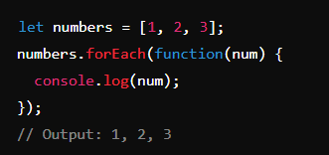
Array Method: forEach
Purpose: Executes a provided function once for each array element.
Syntax :
Example :

Slide 13


Array Method: indexOf
Purpose: Returns the first index at which a given element can be found in the array, or -1 if it is not present.
Syntax :
Example :

Slide 14
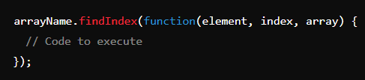
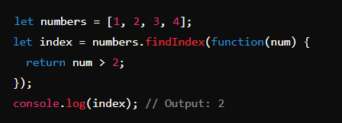
Array Method: findIndex
Purpose: Returns the index of the first element in the array that satisfies the provided testing function. Otherwise, it returns -1.
Syntax :
Example :

Slide 15


Array Method: includes
Purpose: Determines whether an array includes a certain element, returning true or false as appropriate.
Syntax :
Example :

Slide 16

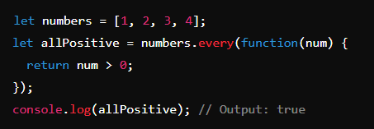
Array Method: every
Purpose: Tests whether all elements in the array pass the test implemented by the provided function.
Syntax :
Example :

Slide 17

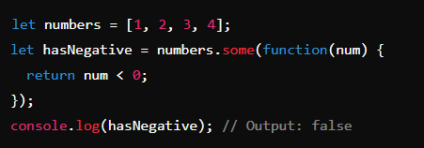
Array Method: some
Purpose: Tests whether at least one element in the array passes the test implemented by the provided function.
Syntax :
Example :

Slide 18
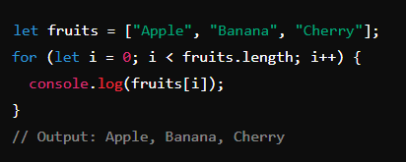
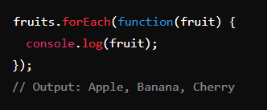
Looping in Arrays
Using for loop :
Using forEach loop :

Slide 19
Summary
Array Methods: Push, Pop, Shift, Unshift, Splice, map, filter, forEach, indexOf, findIndex, includes, every, some.
Looping Techniques: Using for loop and forEach method to iterate over arrays.

